Slide 1
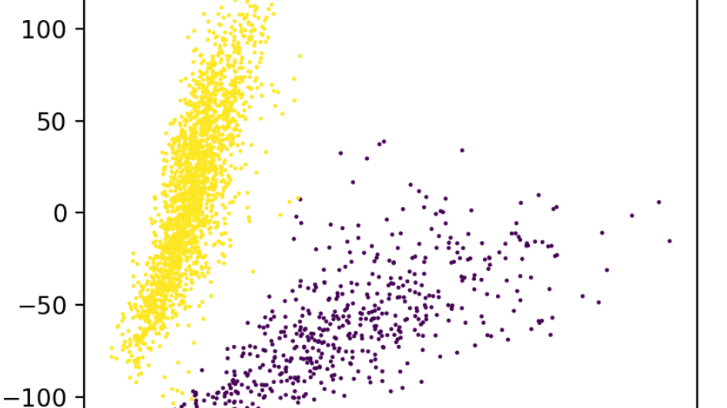
K-means clustering Final presentation
Data analysis project 4, group 2

Slide 2
Filtering
Raw data
2700
32700
Removal of genes that were not expressed in any cells
2700
16600
Removal of outliers by Isolation forest algorithm (optional)
2511
5
PCA
2700
5

Slide 3
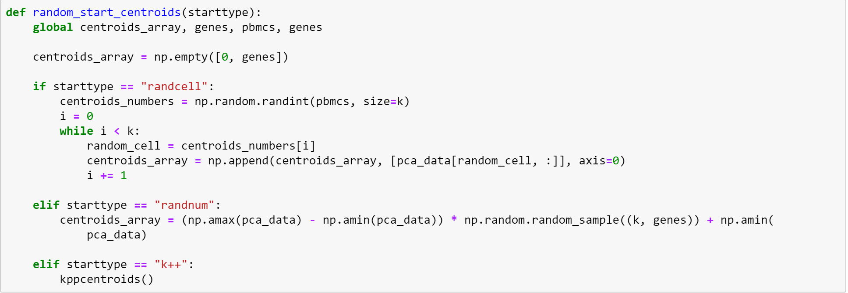
Initial centroid generation
centroids_array | PCA 0 | PCA 1 | PCA 2 | PCA 3 | PCA 4
Cluster center 0 | -20.7 | 16.2 | 43.6 | 10.6 | 13.2
Cluster center 1 | -44.2 | -6.85 | -31.0 | 0.38 | 11.8

Slide 4
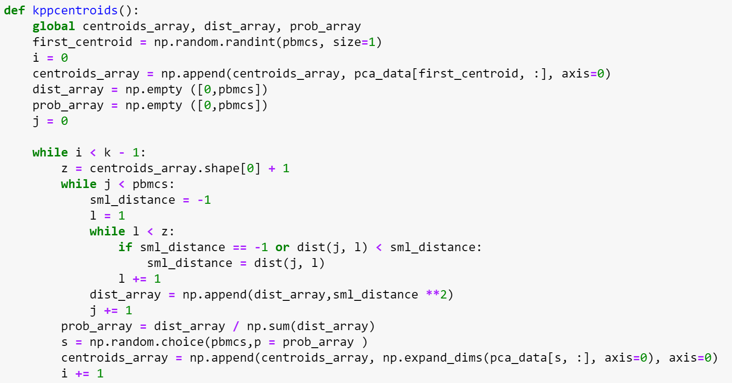
kppcentroids()
prob_array | probability
PBMC 0 | 4.3 * 10⁻⁴
PBMC 1 | 9,9 * 10⁻⁵
PBMC 2 | 3,9 * 10⁻⁴
PBMC 3 | 2,4 * 10⁻⁴
…. | ….
PBMC 2511 | 3,4 * 10⁻⁴

Slide 5
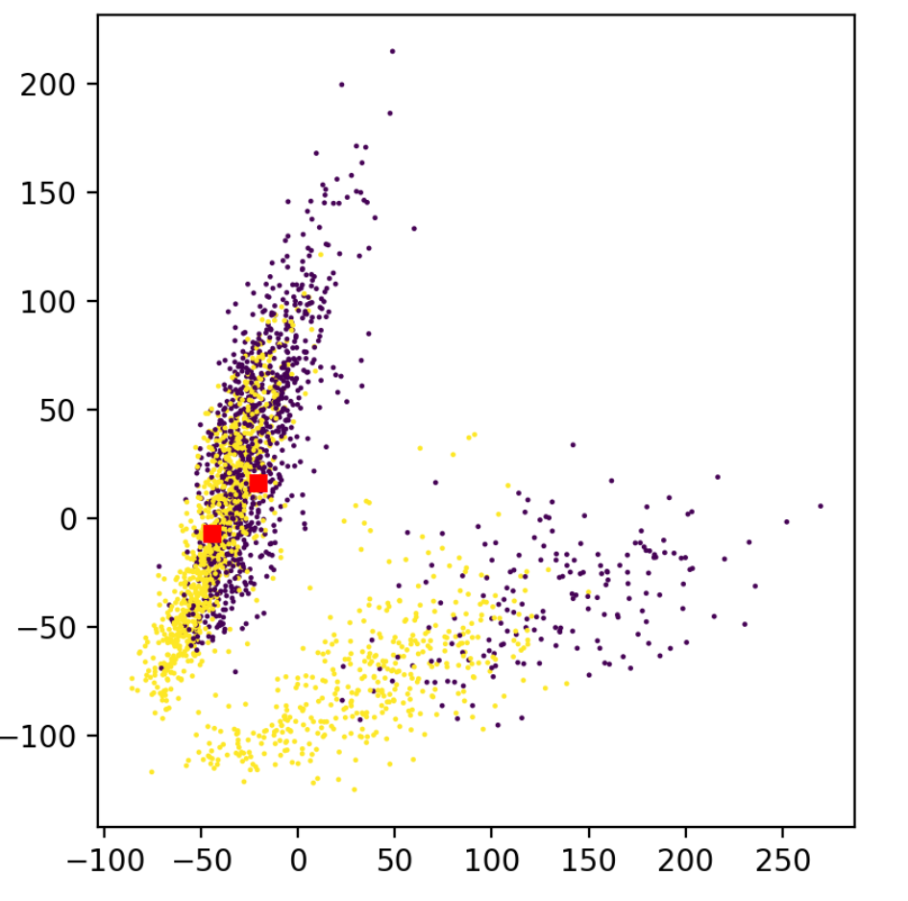
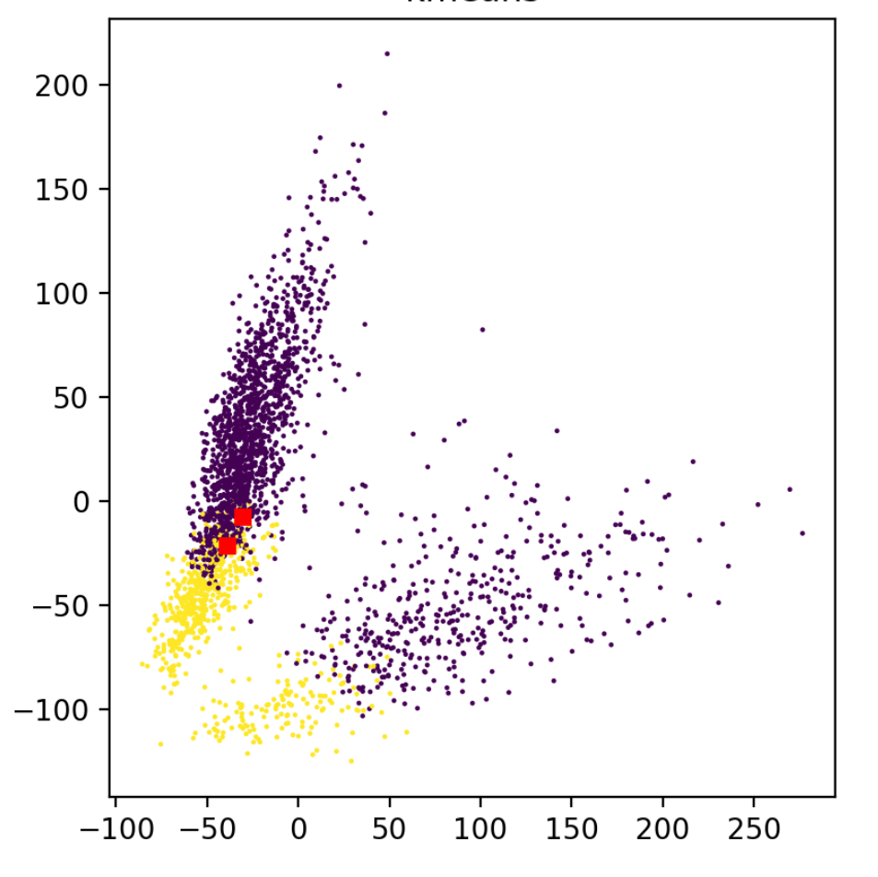
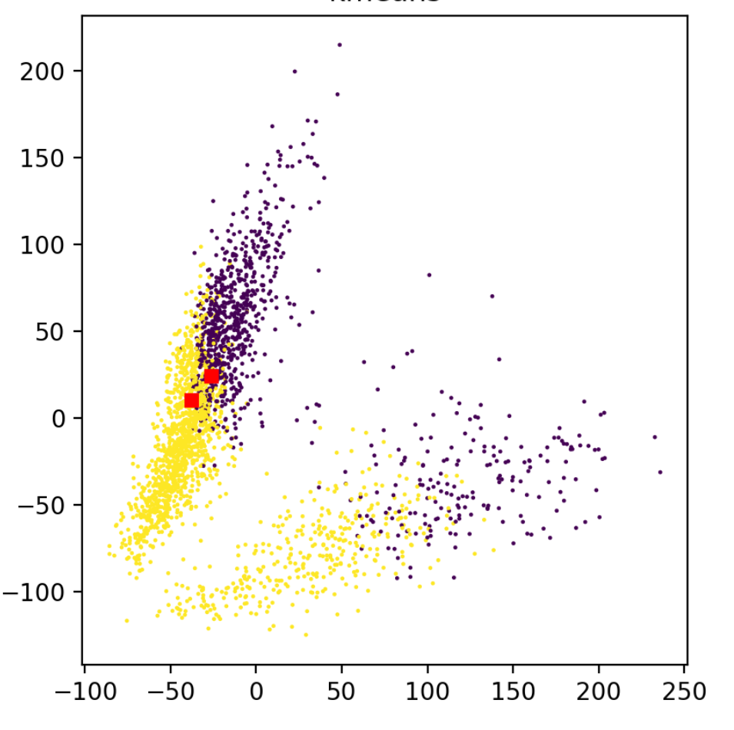
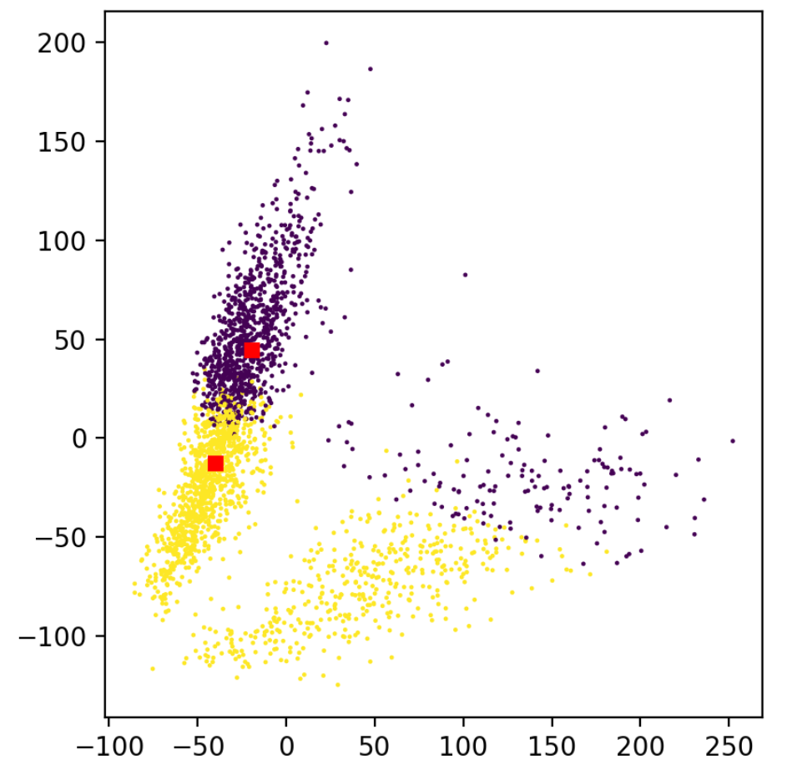
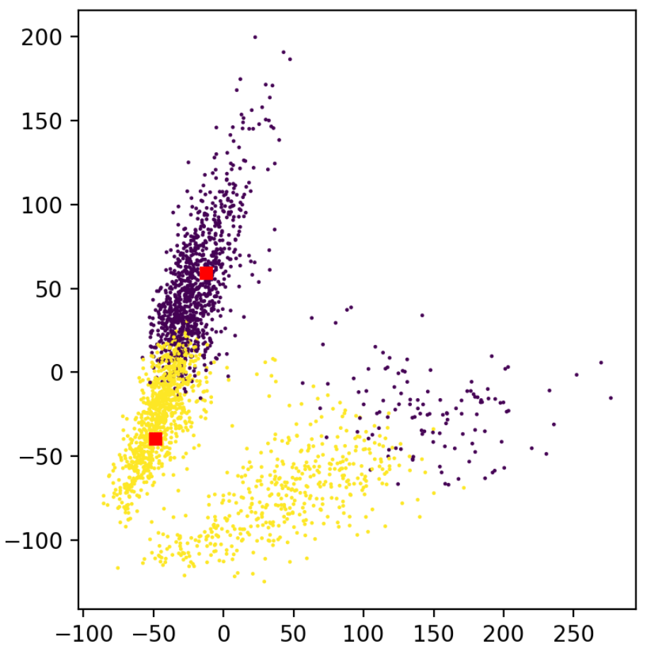
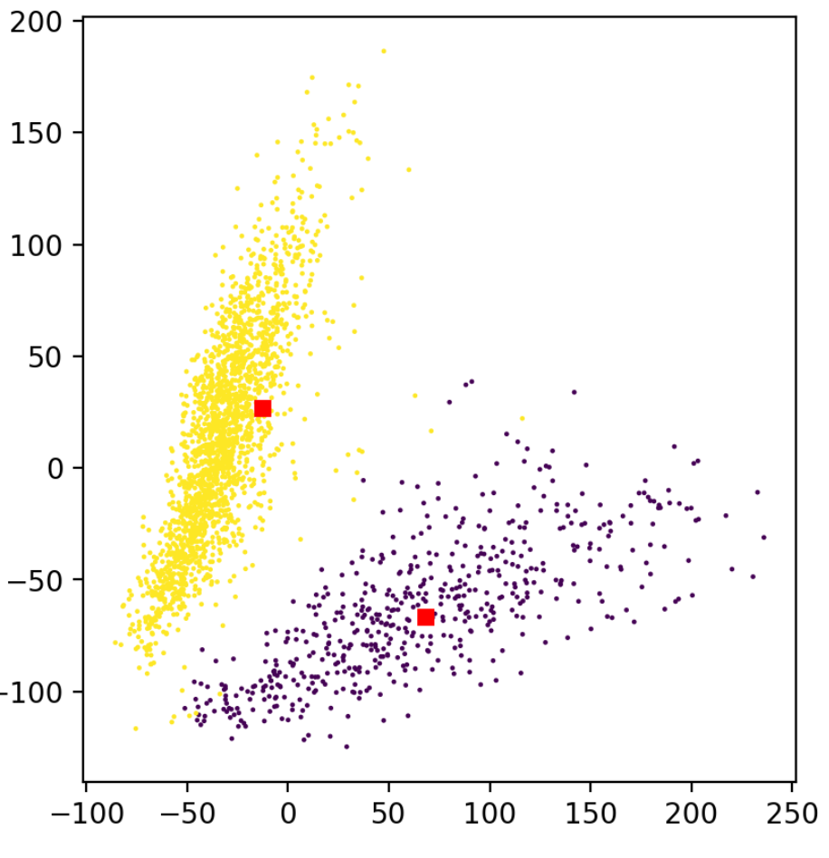

Slide 6
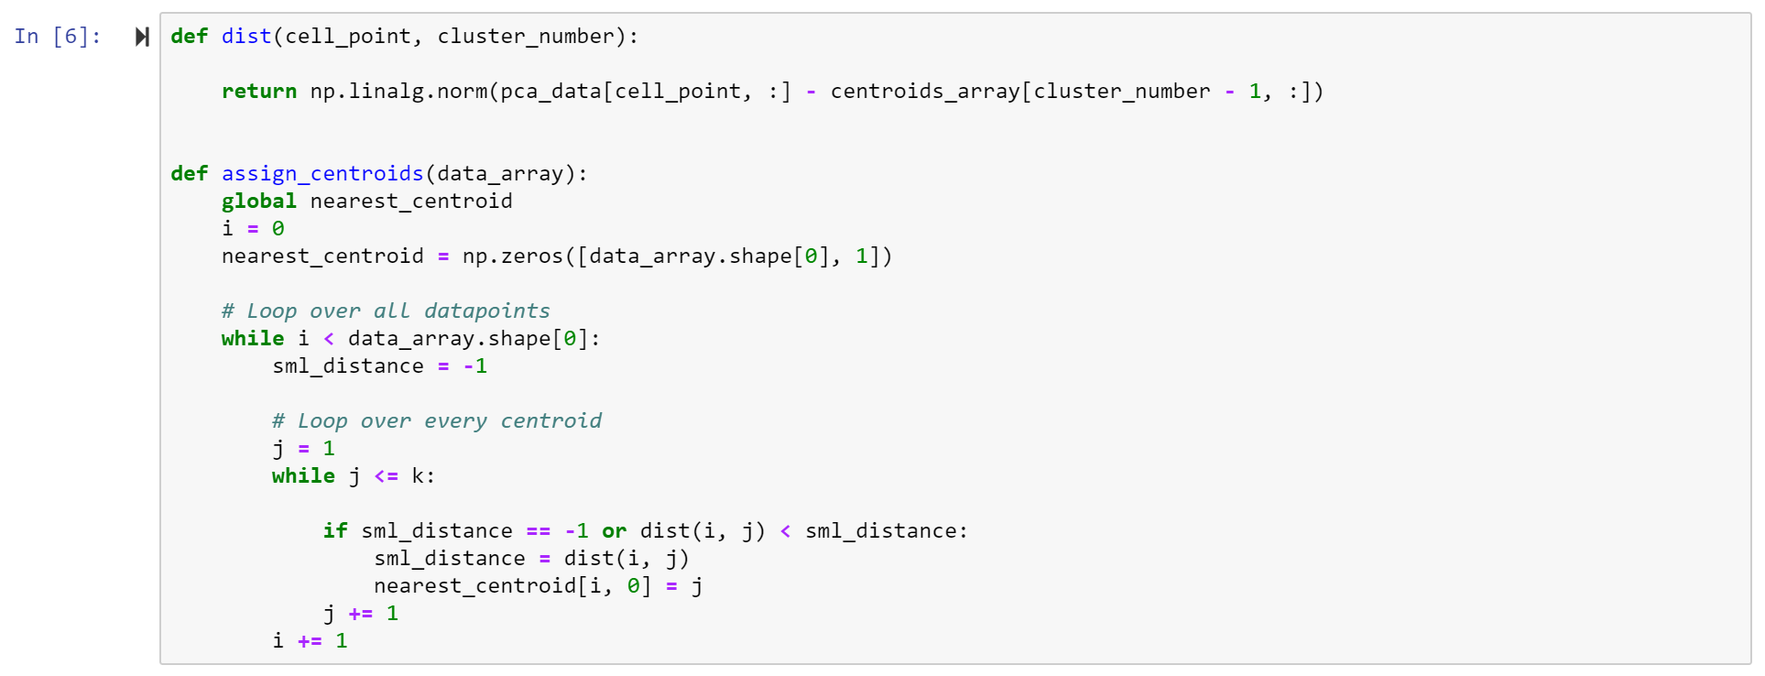
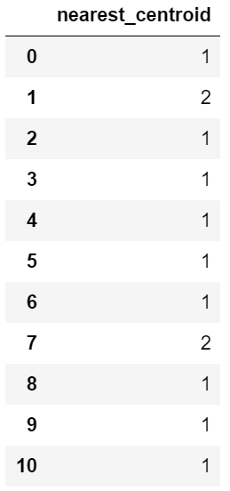
assign_centroids()

Slide 7
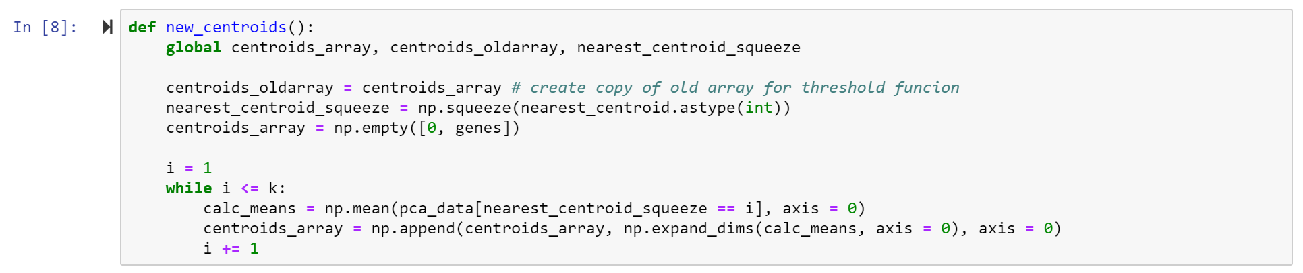
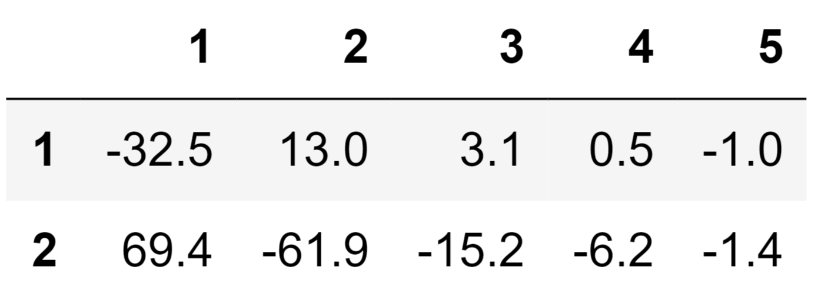
new_centroids()
centroids_array:

Slide 8
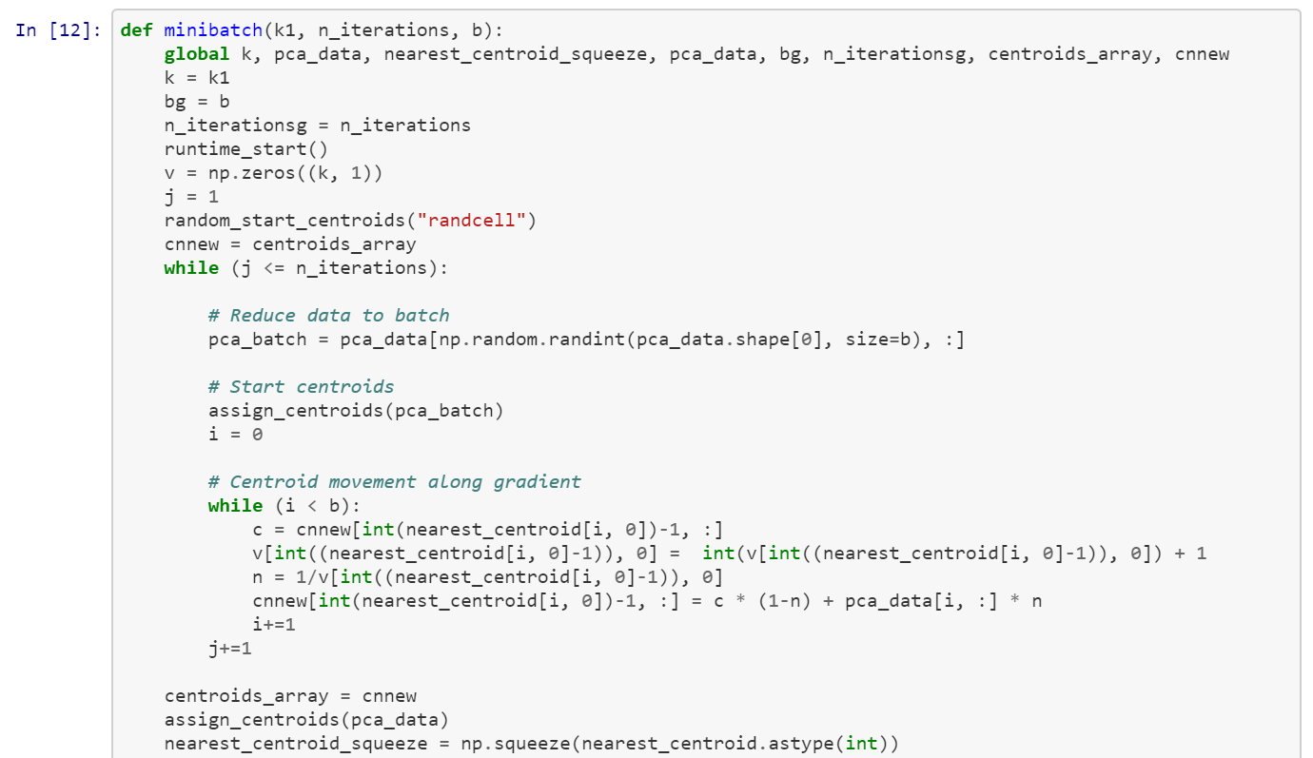
minibatch()
Coordinates of data point assigned centroid
Vector which continuously counts the data points assigned per centroid
Per-center learning rate
Gradient step

Slide 9
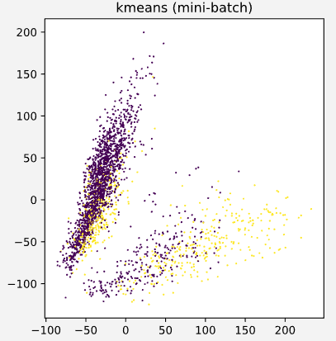
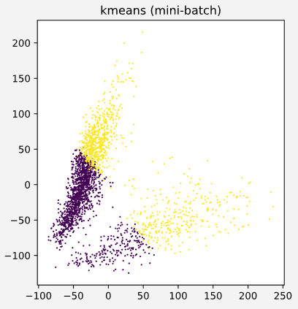
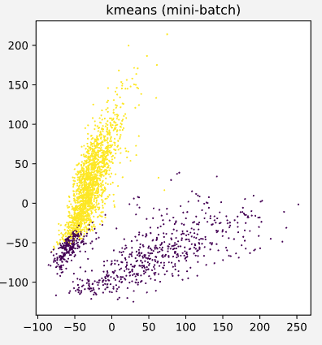
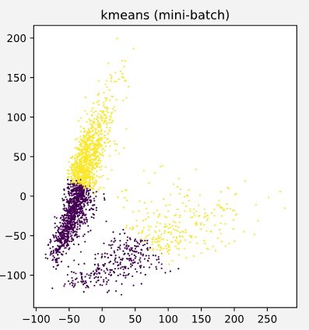
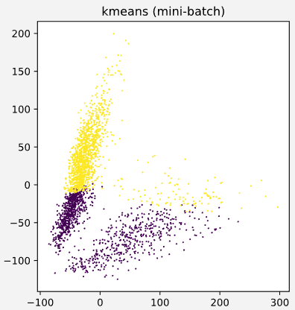
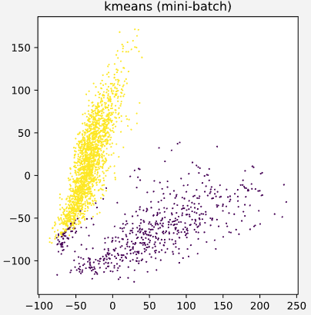
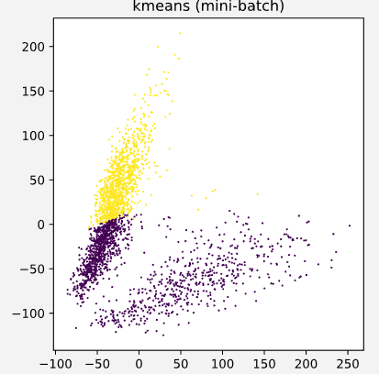
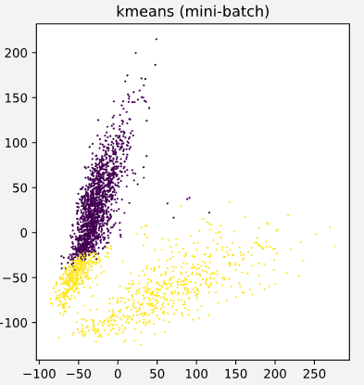
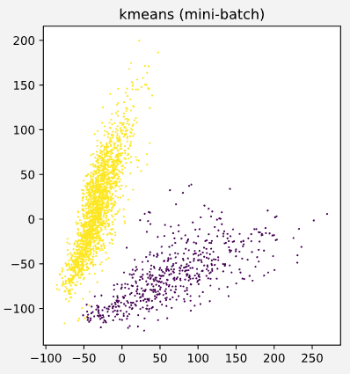
 | b = 500 | b = 1000 | b = 2000
n = 1
n = 5
n = 10

Slide 10
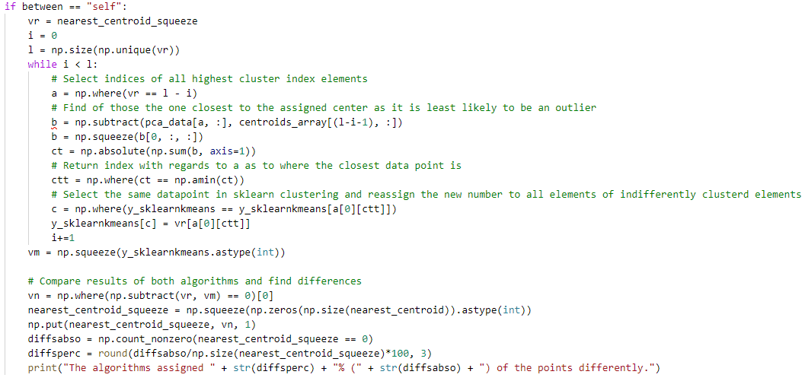
highlightdiffs()

Slide 11
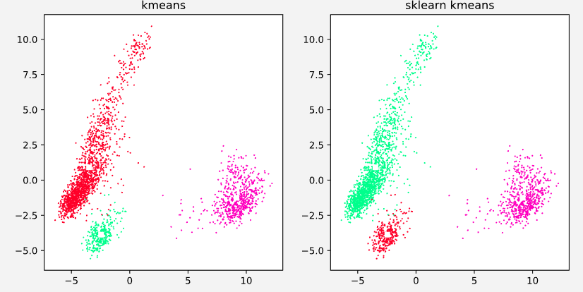
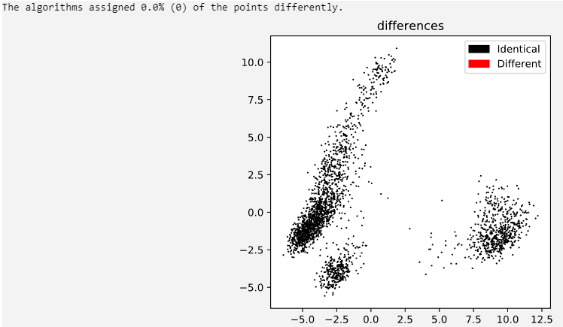
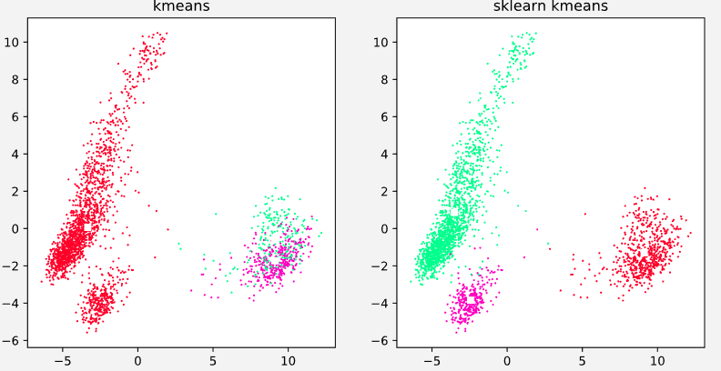
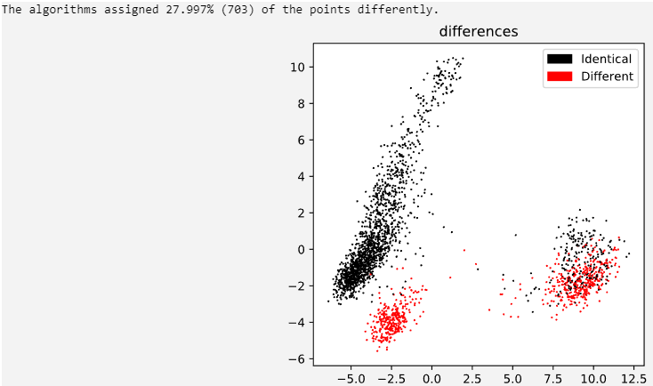

Slide 12
WSS and Runtime comparison with sklearn
Method | WSS Abweichung [%] | Runtime Difference [ms]
Basic K-means | 8,72*10^ -8 | -8,65
Mini-batch K-means | 2,02*10^ -4 | -5,48
K++ | 3,47 *10^ -7 | -7,75

Slide 13
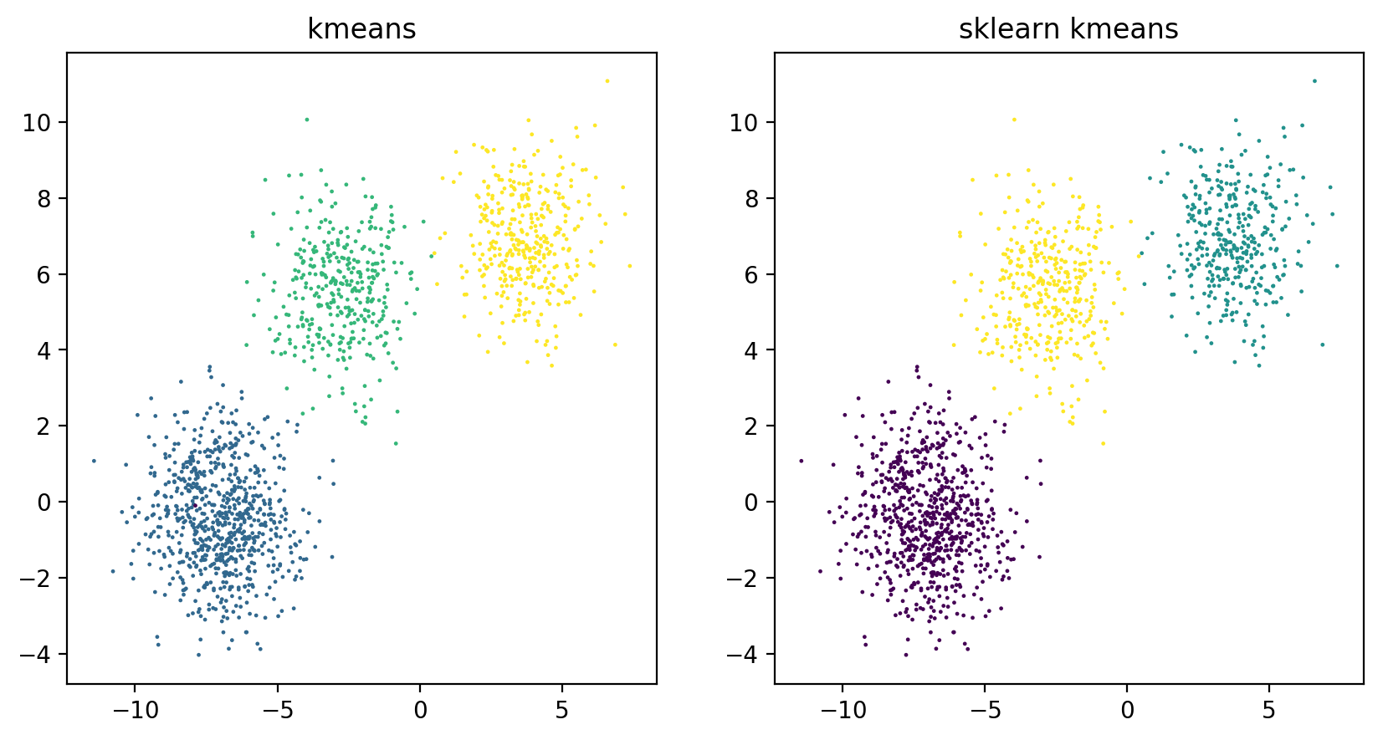
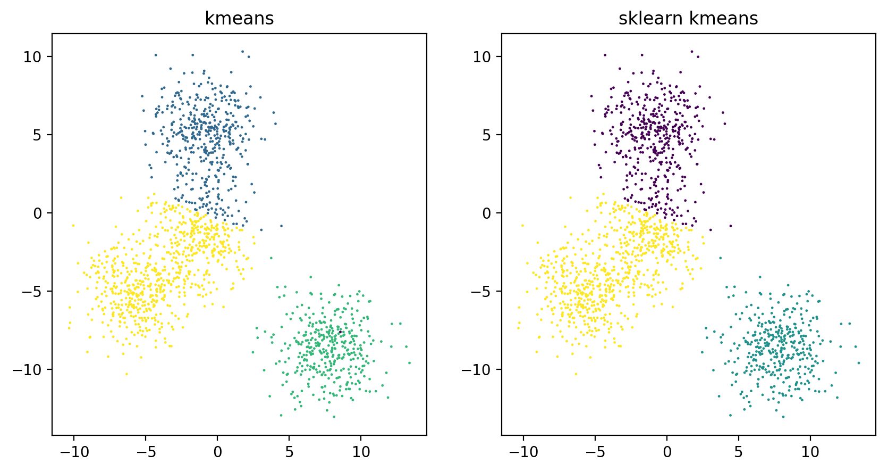
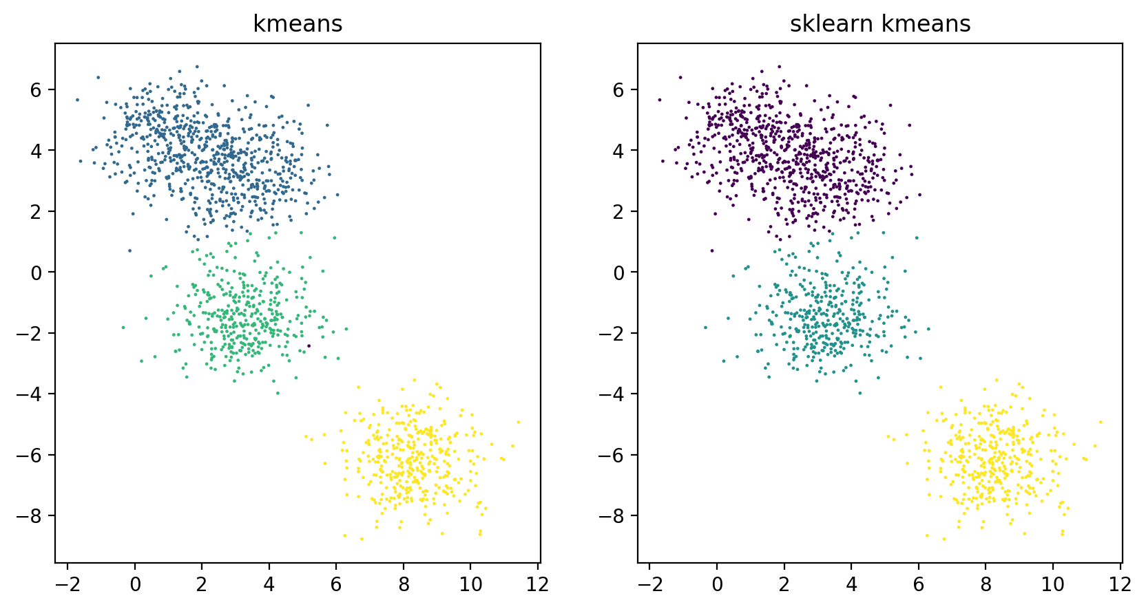
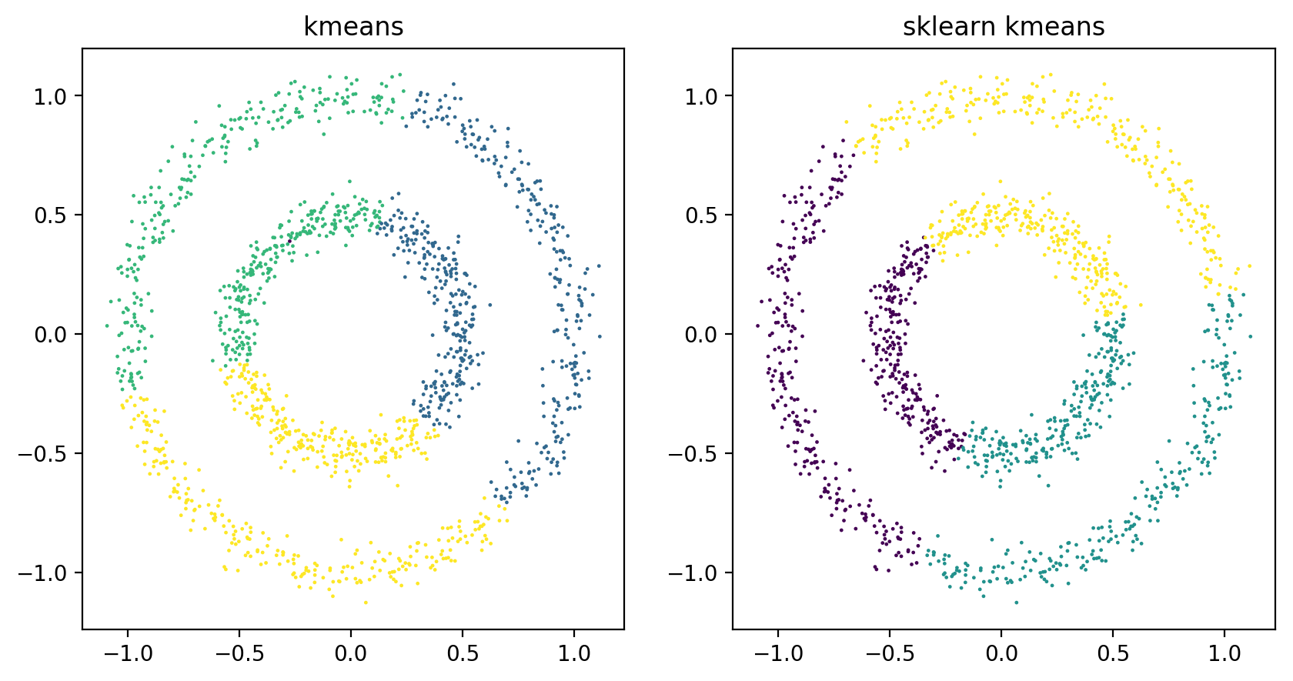
Random Data

